Slide 1
Security Modernizing Concepts
AWS Modernization Team

Slide 2
Modern Security Tenets:
Agile
Automated
Continuous
Collaborative
Rails not gates
Photo & Licence
Notes:
Traditional Security models focus on security review post Dev and test process, these are often manual and time consuming, starting too late in the dev process.
As development and operational workloads become more and more agile like wise Security should evolve to match.
Integrating the Security process into CICD and automation solutions can greatly increase agility, allowing DEV SEC Ops teams to start the security assessment sooner.
Security assessment responding to commits and pull requests in the Source Code Management systems allows for smaller more frequent security assessment, detecting issues sooner and allowing these to be addressed in a more incremental fashion.
Integration with CICD solutions reduced human administrative bottle necks in the process. Any aspect that can be automated should.
Dev and Ops teams should be key stake holders in the security process, defining what and how security goals should be achieved. Making these code owner the owner of security as well builds a tighter investment in making sure that security goals are met. Focus should shift away from building code to releasing code.
No tool in isolation will cater for this, organization and mind set change will be an essential part of this.
Security should focus on building best practice, all parties should understand the risks and why they need to be addressed and how to work together to prevent these.
Security should be prescriptive,
The process should allow dev teams to be guided towards building for security from the start not being blocked and pushed back.

Slide 3
Dev Sec Ops Flow:
Write Code
Commit to repo
Automated Static Code inspection
Build Process
Container images published to repo
Automated code and image inspection
Unit test
Integration tests
Deploy to stage
System tests
Security assessment
Deploy to production
On going security assessment
Notes:
Traditional Security models focus on security review post Dev and test process, these are often manual and time consuming, starting too late in the dev process.
As development and operational workloads become more and more agile like wise Security should evolve to match.

Slide 4
Define risks which can be detected and addressed in code.
Vulnerability's at code / lang level
Exposed Keys
Static encoded credentials
Running as root
Photo & Licence
Notes:
Dev sec ops teams should collaboratively define these risks and how and when to ID and address, Some of these may be valid in certain context e.g TCP port 22 not exposed for production workloads but allowed for troubleshooting contexts.

Slide 5





Static assessment:
AWS CodeBuild
commit to
repo
Pipeline to automate
Security assessment:
Assess based on:
commit,
Pull request
Merge to production.
Process scripts
For static code
assessment
Assessment failing
to pass security results
in communication to
stakeholder s to address
Pass assessment results
in pipeline moving to
build phase, code converted
to container image
Devops
AWS CodeCommit
AWS CodePipeline
AWS
Lambda

Slide 6
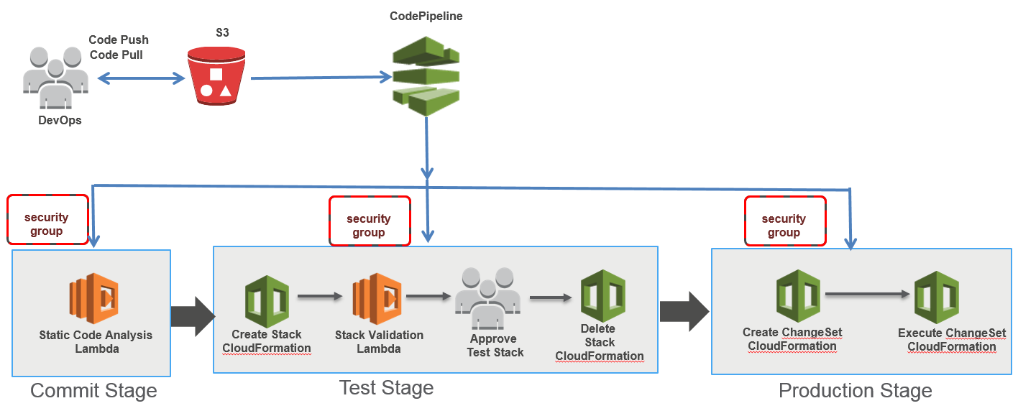
Infrastructure as code static assessment:
Photo & Licence
Notes:
Modernization includes the automation of infrastructure.
This will see much of the dev ops process being managed by infrastructure as code templates.
These templates ca also be inspected via static assessment and integrated into the CICD process.
AWS re:Invent 2017: Automating Security and Compliance Testing of Infrastructure-as- (SID317)
https://www.youtube.com/watch?v=xzQUmil3LBM

Slide 7
Goals:
- Use IAM roles not keys.
Do not provide SSH access to containers.
Use Secrets and config maps instead of static coded credentials.
Start here … add more of you own business rules…

Slide 8
Resources:
Protect against keys being exposed in repos,
https://github.com/awslabs/git-secrets
Limit exposure through infrastructure as code config:
https://aws.amazon.com/blogs/devops/implementing-devsecops-using-aws-codepipeline/
https://www.youtube.com/watch?v=xzQUmil3LBM

Slide 9

Did you pack your own bag?
Did you build your own container images?
How intimately do you know the contents?
Can you trust where they came from?

Slide 10
Container image risks:
Do your containers contain undesirable config?
Do your containers or dependencies contain vulnerabilities?
Container images rafted by internal teams or provided by a trusted source can manifest risks over time.

Slide 11

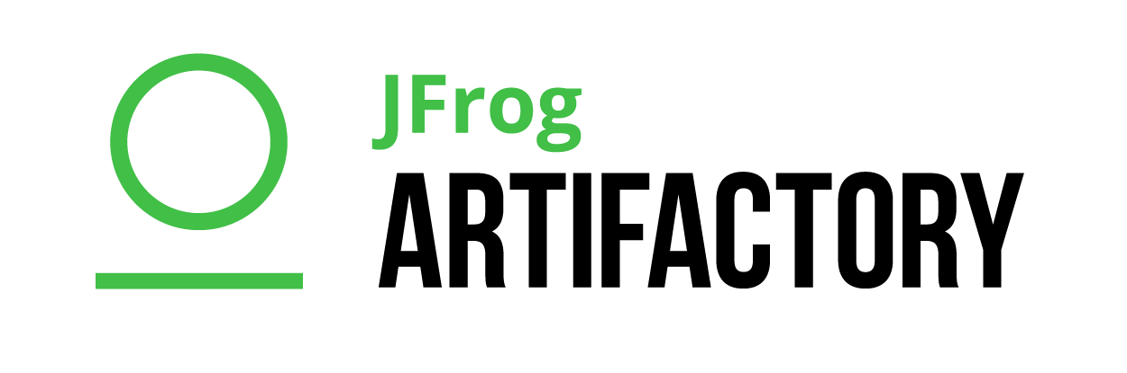

Build your own trusted source:
Source container image repos
Scan container images for vulnerabilities.
Scan previously white listed objects for new risks.
Store white listed artifacts for reuse.
Amazon ECR
Import images to
Assessment repo
Devs build applications using trusted objects.

Slide 12
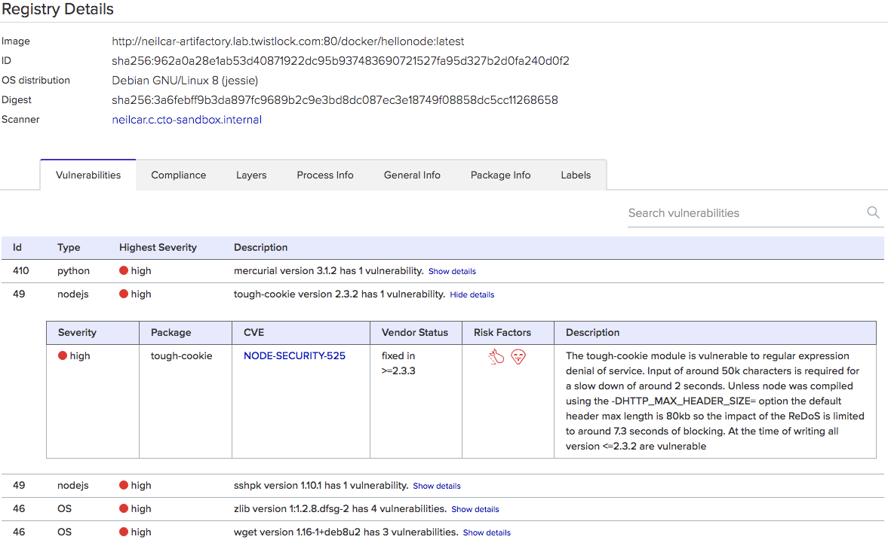

Slide 13
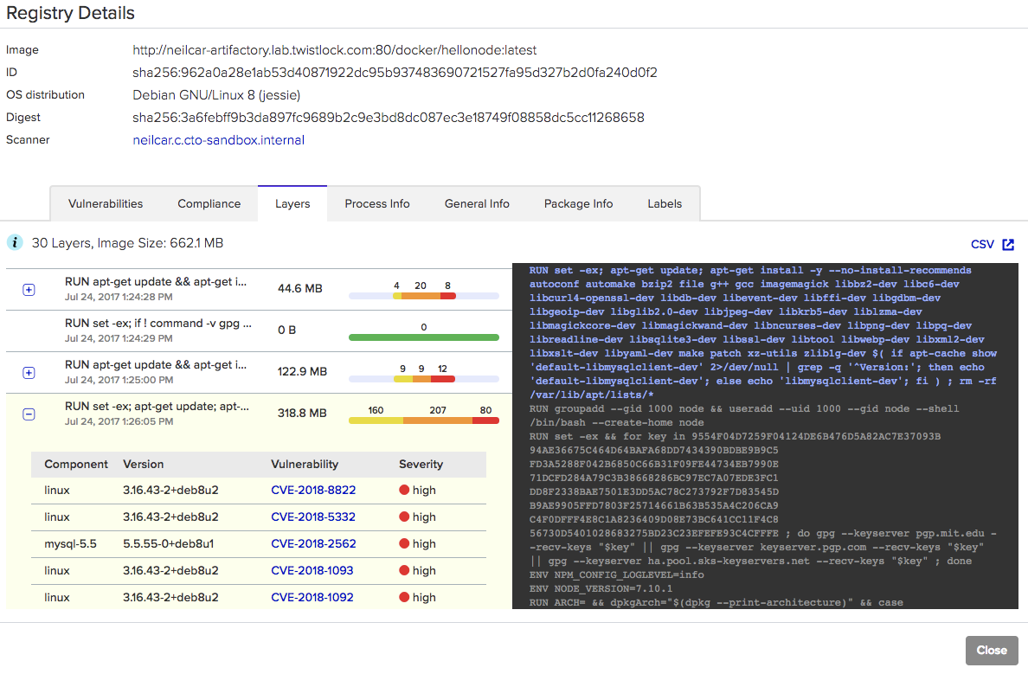

Slide 14
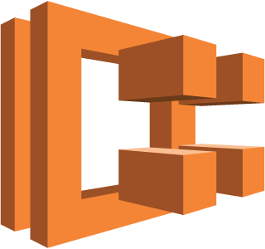



I checked it before, so it should be safe…
Security should be continuous.
Scan what is in production for new risks or post deployment deviations.
Amazon ECS
Amazon Inspector
Continuously assess running workloads
Amazon EC2
Agent and API data
AWS Config
Continuously assess state and configuration

Slide 15
Modern Security Tenets:
Agile
Automated
Continuous
Collaborative
Rails not gates
Photo & Licence
Notes:
Traditional Security models focus on security review post Dev and test process, these are often manual and time consuming, starting too late in the dev process.
As development and operational workloads become more and more agile like wise Security should evolve to match.
Integrating the Security process into CICD and automation solutions can greatly increase agility, allowing DEV SEC Ops teams to start the security assessment sooner.
Security assessment responding to commits and pull requests in the Source Code Management systems allows for smaller more frequent security assessment, detecting issues sooner and allowing these to be addressed in a more incremental fashion.
Integration with CICD solutions reduced human administrative bottle necks in the process. Any aspect that can be automated should.
Dev and Ops teams should be key stake holders in the security process, defining what and how security goals should be achieved. Making these code owner the owner of security as well builds a tighter investment in making sure that security goals are met. Focus should shift away from building code to releasing code.
No tool in isolation will cater for this, organization and mind set change will be an essential part of this.
Security should focus on building best practice, all parties should understand the risks and why they need to be addressed and how to work together to prevent these.
Security should be prescriptive,
The process should allow dev teams to be guided towards building for security from the start not being blocked and pushed back.

